Slide 1
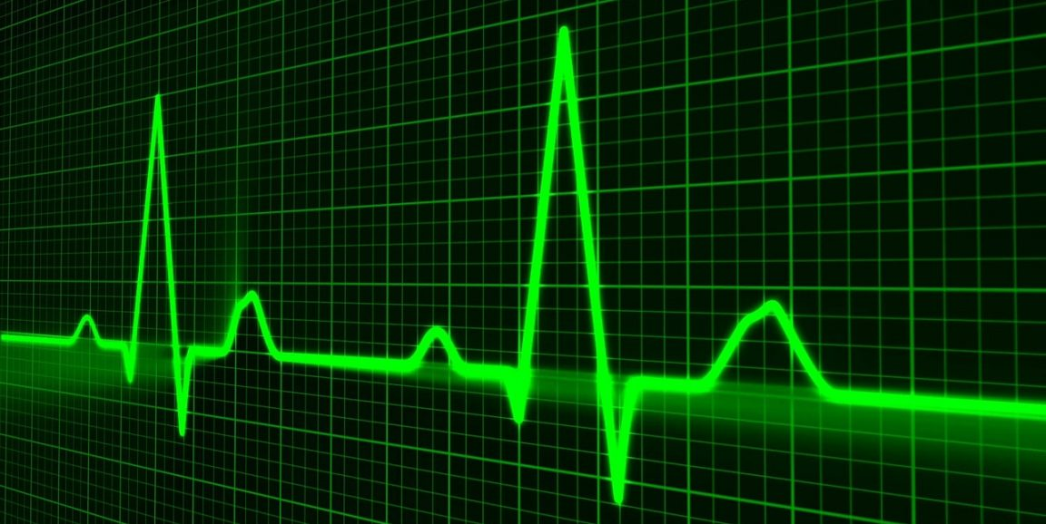
Electrocardiogram Classification by
Convolutional Neural Networks
Arsi Ikäheimonen
Maryam Kiashemshaki
Fig:https://scopeblog.stanford.edu/2016/09/21/electrocardiogram-blog-chronicles-value-of-old-but-still-vital-cardiac-test/

Slide 2
Content:
What are Electrocardiogram and Atrial Fibrillation?
Dataset:
Data Augmentation
Data preprocessing
Models:
Convolutional neural network
Combination of convolutional layers and long-short term memory (LSTM) layers

Slide 3
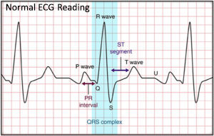
Electrocardiogram
Measures heart’s electrical activity.
Can reveal signs of heart disease and help to predict a heart attack.
Read by experienced cardiologists.
https://www.englewoodhealthphysicians.org/medical-services/heart-care/heart-disease-diagnosis-screening/electrocardiogram/
Notes:
ECG traditionally is reading by expert cardiologist.

Slide 4
Atrial Fibrillation (AF):
is a common heart rhythm disorder.
occurs in 1-2% of the population.
is associated with significant mortality and morbidity.
AF detection is problematic:
It may be episodic.
Can be masked by other rhythms.

Slide 5
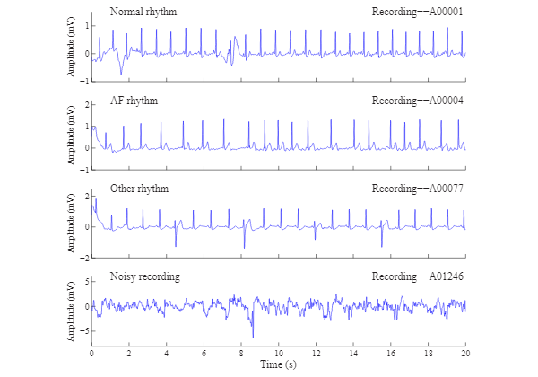
Project goal:
Classifying electrocardiogram (ECG) recordings from a single-channel handheld ECG device into four distinct categories:
Normal sinus rhythm (N)
Atrial fibrillation (A)
Other rhythm (O)
too noisy to be classified (~)
https://physionet.org/files/challenge-2017/1.0.0/example_waveforms.svg

Slide 6
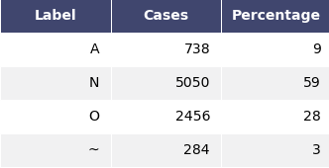
Dataset
Provided by the PhysioNet Challenge 2017
The training set contains 8,528 single lead ECG recordings lasting from 9 s to just over 60 s
Data are provided in MATLAB V4 WFDB-compliant format.
Notes:
Donated by AliveCor mobile ECG device is capable of recording ECG

Slide 7
Method:
Pre-processing of data
Pre-trained neural network / Transfer learning
Evaluation

Slide 8
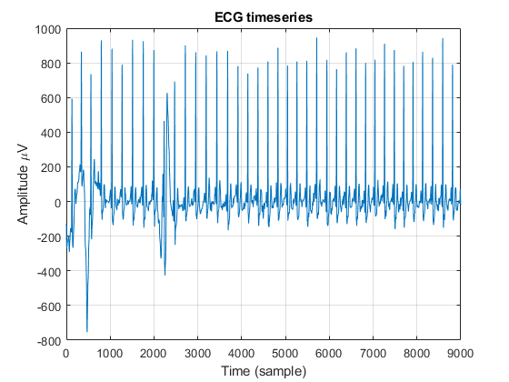
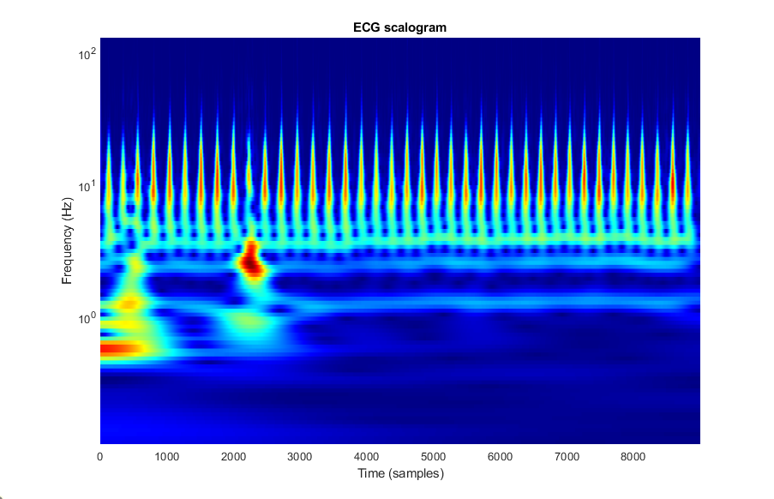
Pre-processing of data:
Filtering ???
Data augmentation
5050 ( 9 seconds) / class
Normalization
Wavelet transform
Scalogram

Slide 9
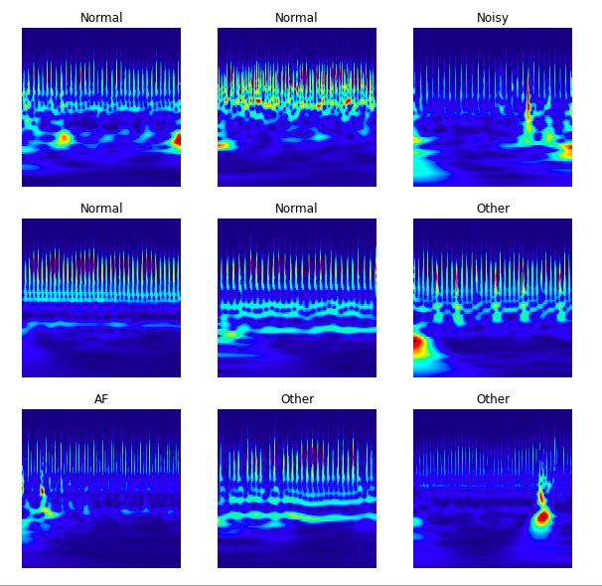
Scalogram samples

Slide 10
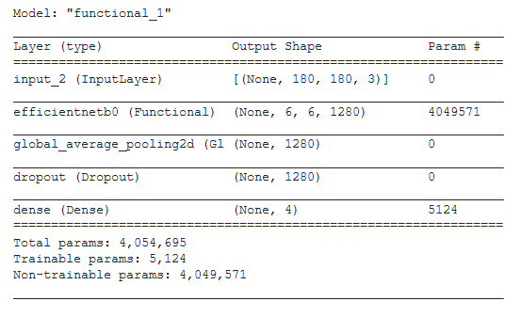
Model
Transfer learning
Efficientnetb0 (trained on imagenet)
LSTM layers (not implemented)

Slide 11
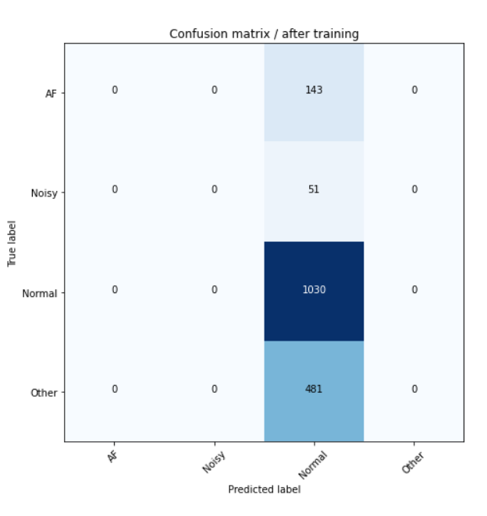
Evaluation
Confusion matrix
ROC curve ( not implemented yet )
Validation accuracy ~ 60%

Slide 12
Results
~60%

Slide 13

Thank you!
Any question?

Slide 14
References:
https://physionet.org/content/challenge-2017/1.0.0/
http://www.cinc.org/archives/2017/pdf/070-060.pdf
https://github.com/awerdich/physionet

